Slide 1
Module 2: Radicalism
Online Radicalisation
Analysing the role of the internet and social media in radicalisation and recruitment
Укрепване на капацитет, обмен на опит и изследователска дейност в сферата на сигурността, BG65ISPR001-3.004-0002
Andrew Staniforth – December 2024

Slide 2
Online Radicalisation
The aim of this session is to examine and explore the impact of the internet and social media on the radicalisation and recruitment of individuals towards violent extremism and terrorism, including countermeasures to prevent terrorist content online.

Slide 3
Online Radicalisation
Analysing the role of the internet and social media in radicalisation and recruitment:
Part 1: Online terror threats
Part 2: Online terrorist activity
Part 3:Countermeasures
Part 4: Terrorist Content Online Regulation

Slide 4

Online Radicalisation

Slide 5
Online Radicalisation
Scale of the challenge in 2022:
Facebook removed a total of 54 million items of terrorist content
YouTube removed 273,016 videos that promoted violence and violent extremism
Twitter suspended a total of 112,360 accounts for the same reason

Slide 6

Part 1: Online Terror Threats
Why do terrorist’s use the internet to conduct their operations?

Slide 7

Part 1: Online Terror Threats
Limitless content
Efficient recruitment
Low barrier of access
Unregulated domain
Anonymity Encryption privacy
Expert knowledge
Multidirectional communications
Targeting the vulnerable

Slide 8
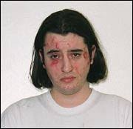

Part 1: Online Terror Threats
Case study: Younes Tsouli
Moroccan born
‘Irhabi 007’ / ‘Terrorst 007’
London, UK, 2005
Targeted military personnel
Social media surveillance
€2.5million fraudulent transactions
16-year custodial sentence

Slide 9

Part 2: Online Terrorist Activity
Tech Against Terrorism Report “The Threat of Terrorist and Violent Extremist Operated Websites”
terrorist and violent extremist actors were running at least 198 websites on the surface web.
Further in-depth analysis of 33 of the most prominent websites – run by actors such as IS Al Qaeda, Atomwaffen Division, and the Taliban – confirmed that these sites had 1.54 million monthly visitors, with the majority of visits coming from Algeria, Pakistan, United States, and the UK

Slide 10
Part 2: Online Terrorist Activity
Tech Against Terrorism “Transparency Report of the Terrorist Content Analytics Platform (TCAP) 2023”
Open-source intelligence experts submitted 18,995 URLs containing terrorist content, and the TCAP sent 10,174 alerts to 57 tech companies, 82% of which are now offline
18,048 URLs containing Islamist terrorist content were submitted to the TCAP
947 URLs containing far-right terrorist content.
9,436 alerts containing Islamist terrorist content were sent tech companies
738 alerts containing far-right content were sent to tech companies

Slide 11

Part 3: Countermeasures
What can we do to counter the online terror threat?

Slide 12

Part 3: Countermeasures
Global Network on Extremism and technology (GNET) report (2023) ‘Tackling Online Terrorist Content Together: Cooperation between Counterterrorism Law Enforcement and Technology Companies”
experience exchange programme
joint upstreaming programme,
Take-down shutdown policy
Joint strategic research requirements
“As the sustained threat from terrorism in all its forms persists, a more progressive, cooperative and collaborative partnership between law enforcement agencies and tech companies must be encouraged.”

Slide 13

Part 4: TCO Regulation

Slide 14

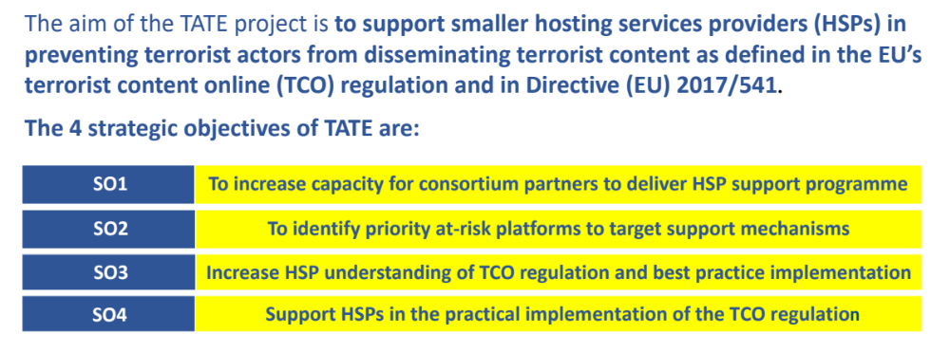
Part 4: TCO Regulation

Slide 15
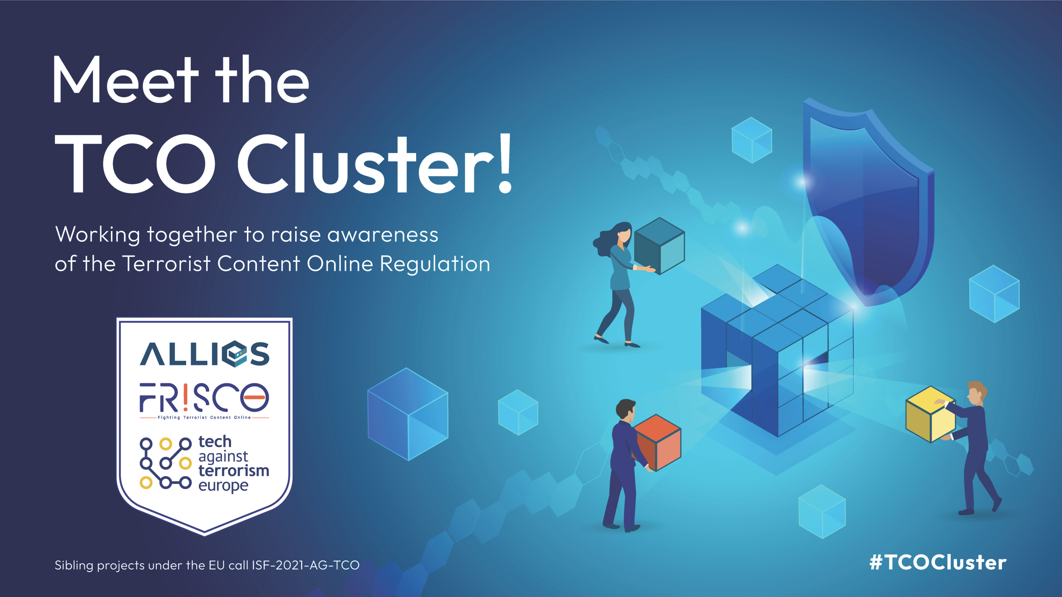
Part 4: TCO Regulation

Slide 16

Key Takeaways

Slide 17
Module 2: Radicalism
Online Radicalisation
Analysing the role of the internet and social media in radicalisation and recruitment
Укрепване на капацитет, обмен на опит и изследователска дейност в сферата на сигурността, BG65ISPR001-3.004-0002
THANK YOU

